Slide 1

Vel Tech Rangarajan Dr. Sagunthala R&D Institute of Science and Technology
School of Computing
Department of Computer Science and Engineering
10211CS224 / FULL STACK APPLICATION DEVELOPMENT (JAVA)
END SEMESTER PROJECT REVIEW
Date: 06-05-2026
SMART CAMPUS EVENT MANAGEMENT SYSTEM
SDG: SDG No – SDG Title(Example: SDG 4 – Quality Education)
Presented By:
K.CHARANDEEPAK– VTU26523– 23UECS0756
Courses Handling Faculty:
Dr.Hafizur Rahman - Assistant Professor

Slide 2
INTRODUCTION
The College Event Registration Portal developed using React JS is a dedicated
web-based platform aimed at simplifying and organizing the management of de_x0002_partmental events within academic institutions. In most colleges, activities such as hackathons, seminars, workshops, and cultural programs are conducted regularly, yet the coordination of these events often relies on fragmented communication chan_x0002_nels such as notice boards and messaging applications, leading to inefficiencies in information delivery . Students may miss important updates or deadlines, while organizers face challenges in maintaining accurate participant records using manual methods like spreadsheets or paper forms To address these challenges, this project introduces a centralized digital solution that connects students and event organizers through a single, user-friendly interface. The application is built using a modern full-stack approach, where React JS pro_x0002_vides a responsive and dynamic frontend, and Node.js with Express handles back_x0002_end operations and API communication efficiently
1
2
3
4
5
6
7
8
9

Slide 3
PROBLEM STATEMENT
1. Inconsistent Data Integrity: In the absence of a structured relational database system, there is no centralized mechanism to associate student information with specific event records. This results in data duplication, inconsistencies, and a high risk of mismatched registration details.
2. Absence of Self-Service Access: Students are unable to independently verify their registration status or view previously enrolled events. This dependency on organizers for basic information increases communication overhead and delays.
3. Limited Search and Filtering Capabilities: As the number of events increases, students face difficulty in identifying relevant opportunities due to the lack of filtering options based on category, date, or event type.
4. Ineffective Capacity Control: Manual registration methods do not support
automatic enforcement of participant limits, resulting in overbooking and mismanagement of venue capacity during high-demand events.
5. Security and Access Limitations: Common tools such as shared forms do not provide adequate access control, making it difficult to restrict administrative actions and safeguard sensitive student data.
1
2
3
4
5
6
7
8
9

Slide 4
OBJECTIVE(S)
The key objectives of this project are outlined as follows:
To develop a fully functional web application using React JS that enables efficient handling of college event registrations through a modern and intuitive interface .
To implement an administrative module that provides authorized users with the ability to create, modify, and remove event details while maintaining data con_x0002_sistency and control .
To utilize MySQL as a relational database system for secure, organized, and persistent storage of event and student-related information .
To design a student-centric interface that allows users to browse events based on categories, view detailed information, and complete registrations with minimal effort .
To incorporate a feature that enables students to track and verify their registered events, improving transparency and reducing dependency on organizers .
1
2
3
4
5
6
7
8
9

Slide 5
PROPOSED SYSTEM
The analysis of existing methods reveals several limitations related to accessi_x0002_bility, data handling, and system efficiency. To overcome these issues, the proposed Event Registration Portal is necessary for the following reasons:
Real-Time Updates: The system ensures that users receive instant information regarding event availability, reducing the risk of overbooking and improving transparency .
Interactive User Experience: By leveraging React JS, the application delivers a smooth and responsive interface, enabling users to navigate and register without unnecessary delays or page reloads .
Centralized Data Storage: The integration of a MySQL database replaces scattered data sources, ensuring secure, consistent, and easily retrievable records of events and participants.
Automated Processes: The system reduces manual intervention by automating registration confirmation and data handling, thereby improving efficiency for both students and administrators
1
2
3
4
5
6
7
8
9

Slide 6
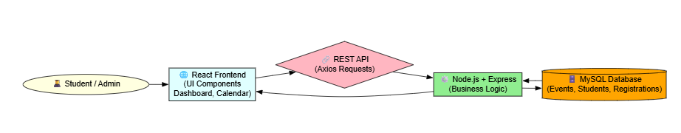
PROPOSED SYSTEM ARCHITECTURE
1
The overall design of the Event Registration Portal follows a modular and lay_x0002_ered architecture, enabling clear separation between the frontend and backend sys_x0002_tems. This structure ensures scalability, maintainability, and efficient communication through RESTful APIs.
2
3
4
5
6
7
8
9

Slide 7
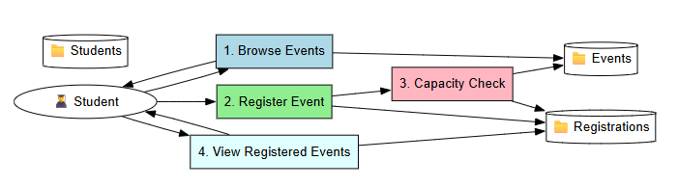

WORKFLOW
1
The Data Flow Diagram (DFD) represents how information moves through the system, highlighting interactions between users, processes, and data stores,depicts the logical flow of data within the system, showing how user inputs are processed, validated, and stored, and how results are delivered back to the user interface.
2
3
4
5
6
7
8
9

Slide 8
TECHNOLOGIES USED
The system is developed using the following technologies:
Frontend: React JS, HTML5, CSS3, JavaScript (ES6+), React Router, Axios for handling API requests and building dynamic user interfaces .
Backend: Node.js and Express framework for managing server-side logic and handling RESTful API communication .
Database: MySQL, a relational database system used for efficient data storage, retrieval, and management .
Development Tools: Visual Studio Code (VS Code), Node.js runtime environ_x0002_ment, and npm for package management and project setup .
Hardware Requirements: Minimum 4GB RAM, Intel i3 processor or equiva_x0002_lent, and at least 20GB of available storage.
Software Requirements: Windows/Linux/macOS operating system with a mod_x0002_ern web browser such as Chrome, Edge, or Firefox.
1
2
3
4
5
6
7
8
9

Slide 9
MODULE DESCRIPTION
Module 1: Student Authentication Module
This module handles the login functionality for students using their academic credentials instead of traditional OTP-based systems.
Module 2: Event Browsing and Search Module
This module provides students with the ability to explore and filter available events.
Module 3: Event Registration Module
This module is responsible for handling event enrollment by students.
Module 4: Calendar Management Module
This module provides a visual representation of registered events.
Module 5: Admin Management Module
This module enables administrators to control and manage the entire system.
1
2
3
4
5
6
7
8
9

Slide 10
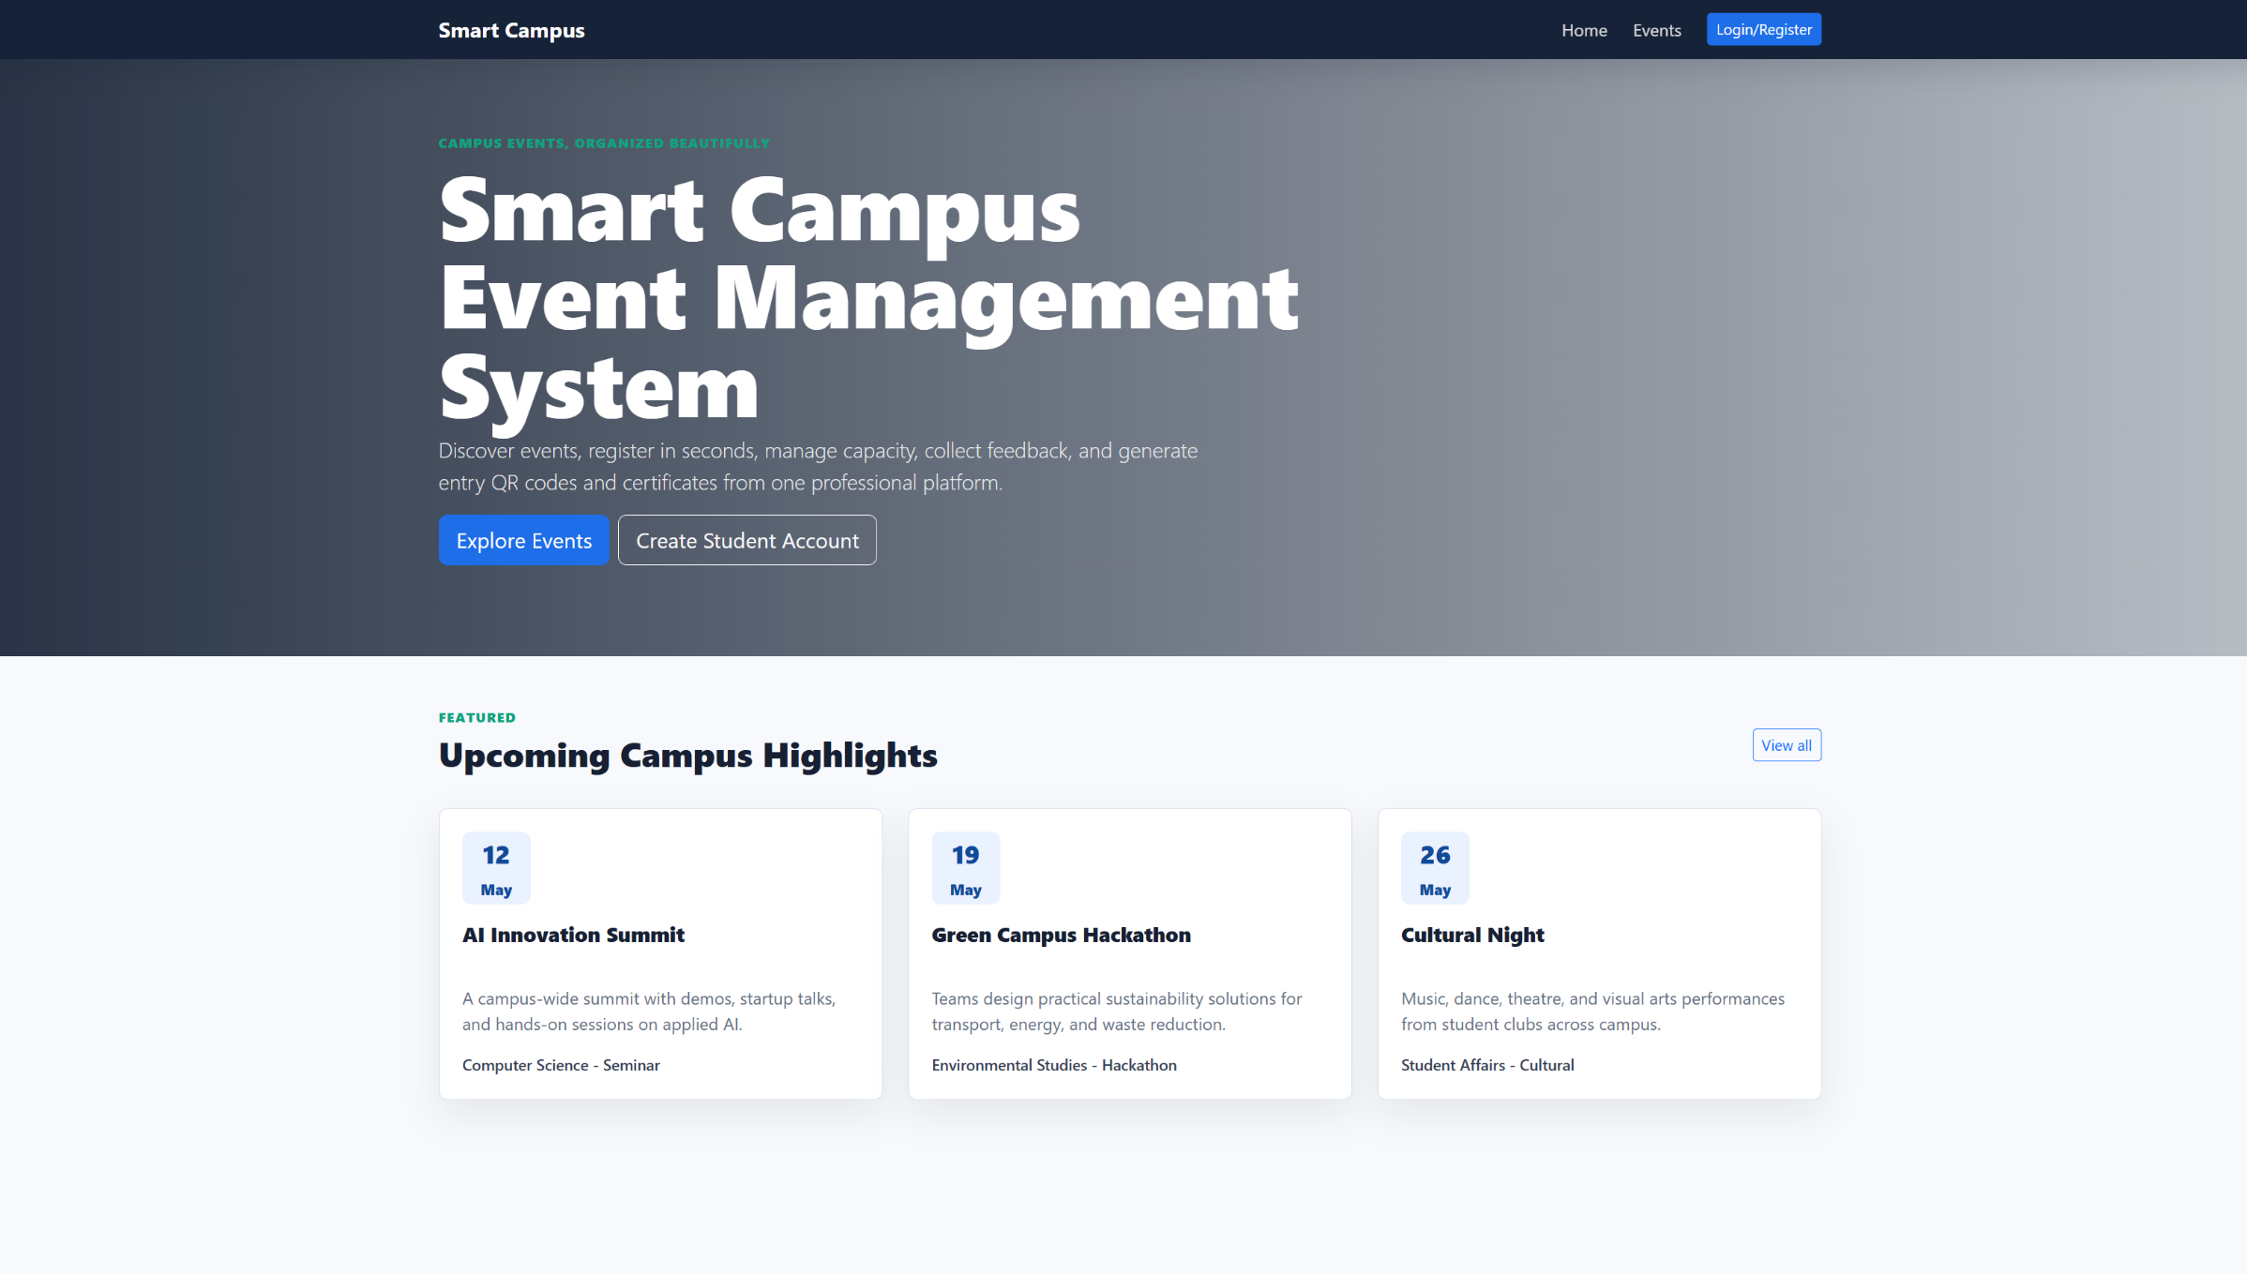
IMPLEMENTATION SCREENSHOTS
The system provides a dedicated interface where users can explore detailed in formation about each event, including description, category, date, and venue.Theinterface dynamically updates based on user interaction, ensuring a smooth browsing experience without page reloads.
1
2
3
4
5
6
7
8
9

Slide 11
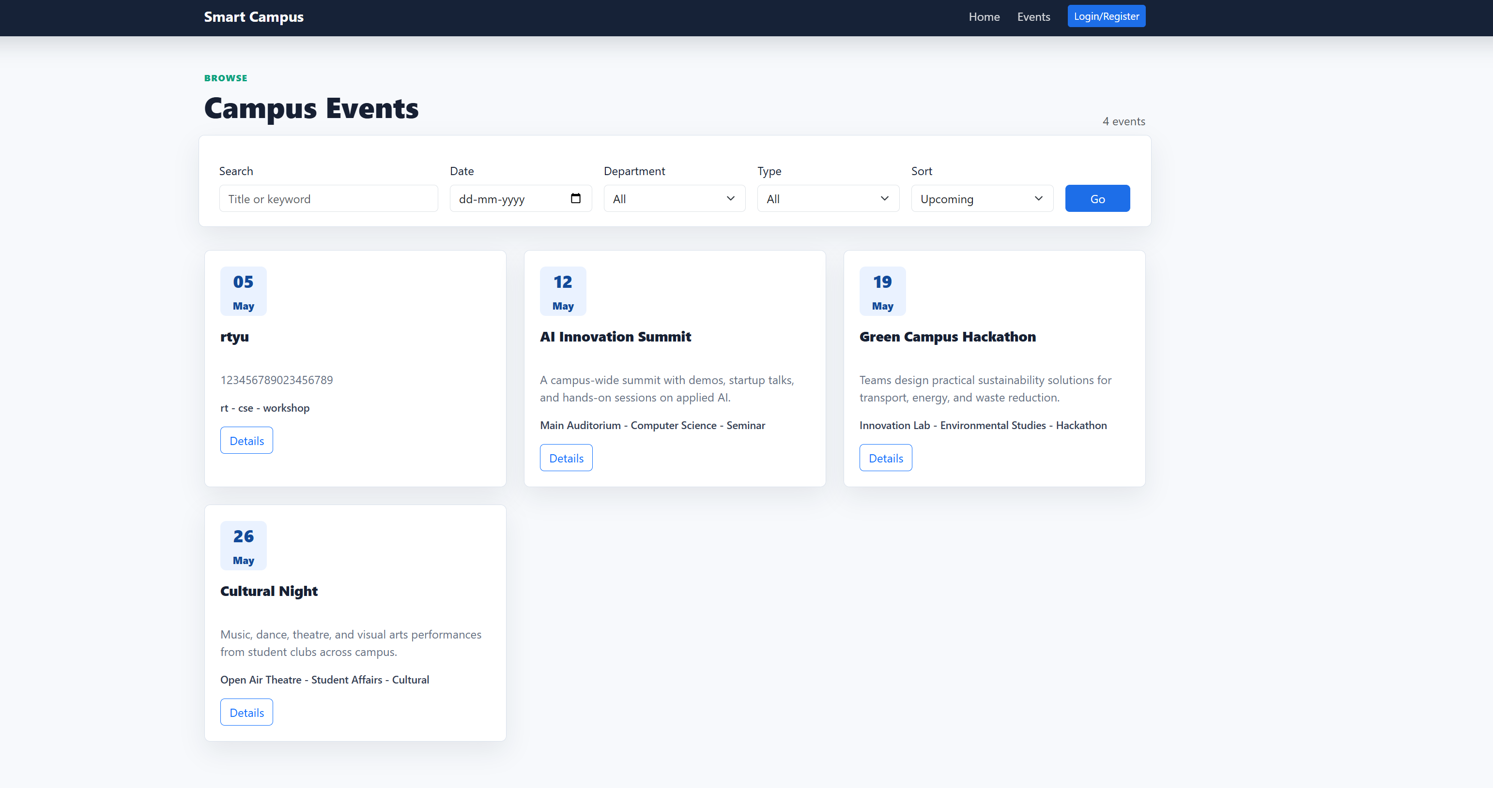
IMPLEMENTATION SCREENSHOTS
The event exploration and selection interface, where multiple categorized events are displayed using card-based layouts.
1
2
3
4
5
6
7
8(A)
9

Slide 12
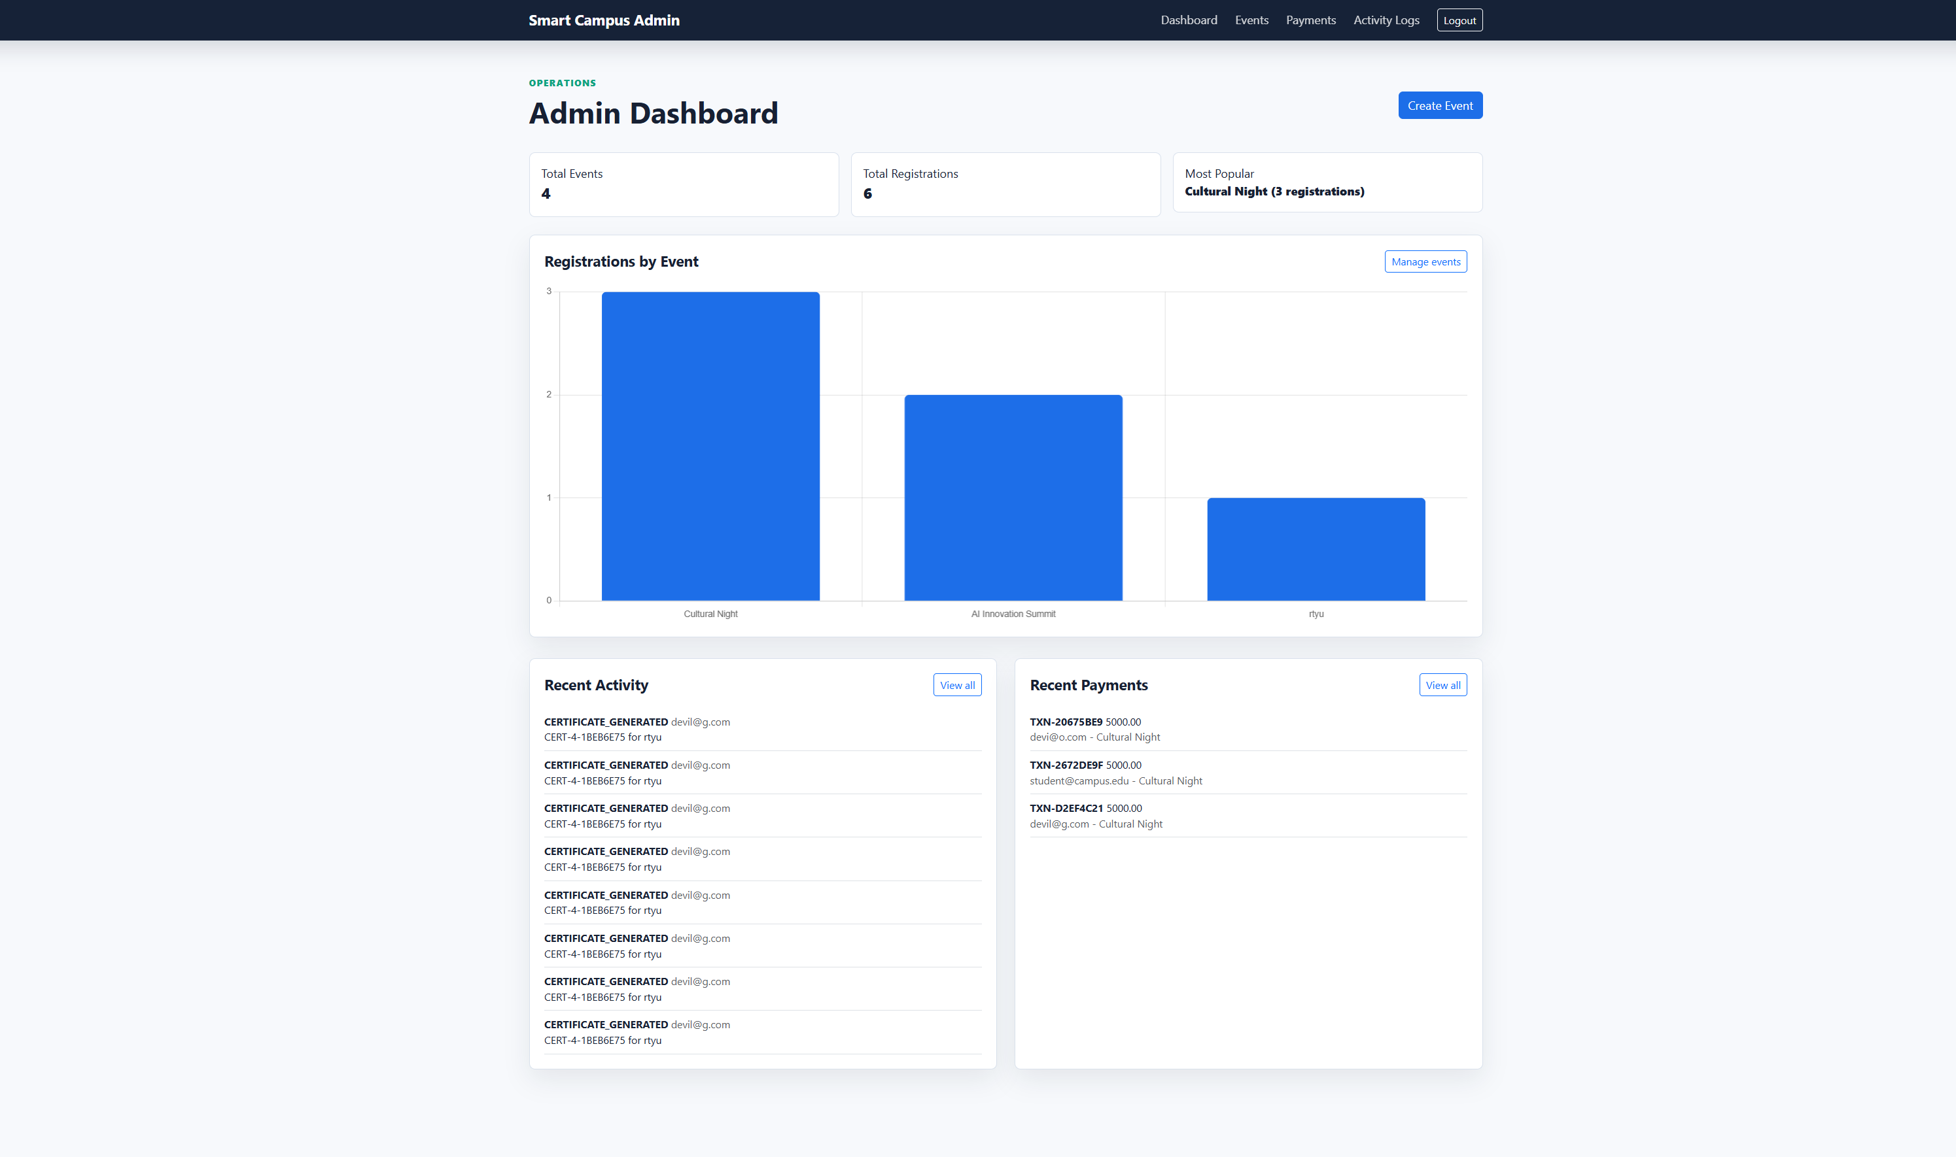
IMPLEMENTATION SCREENSHOTS
The administrative interface enables event organizers to manage event data
efficiently. It provides features such as adding new events, deleting existing ones,
and monitoring participant counts.
1
2
3
4
5
6
7
8(B)
9

Slide 13
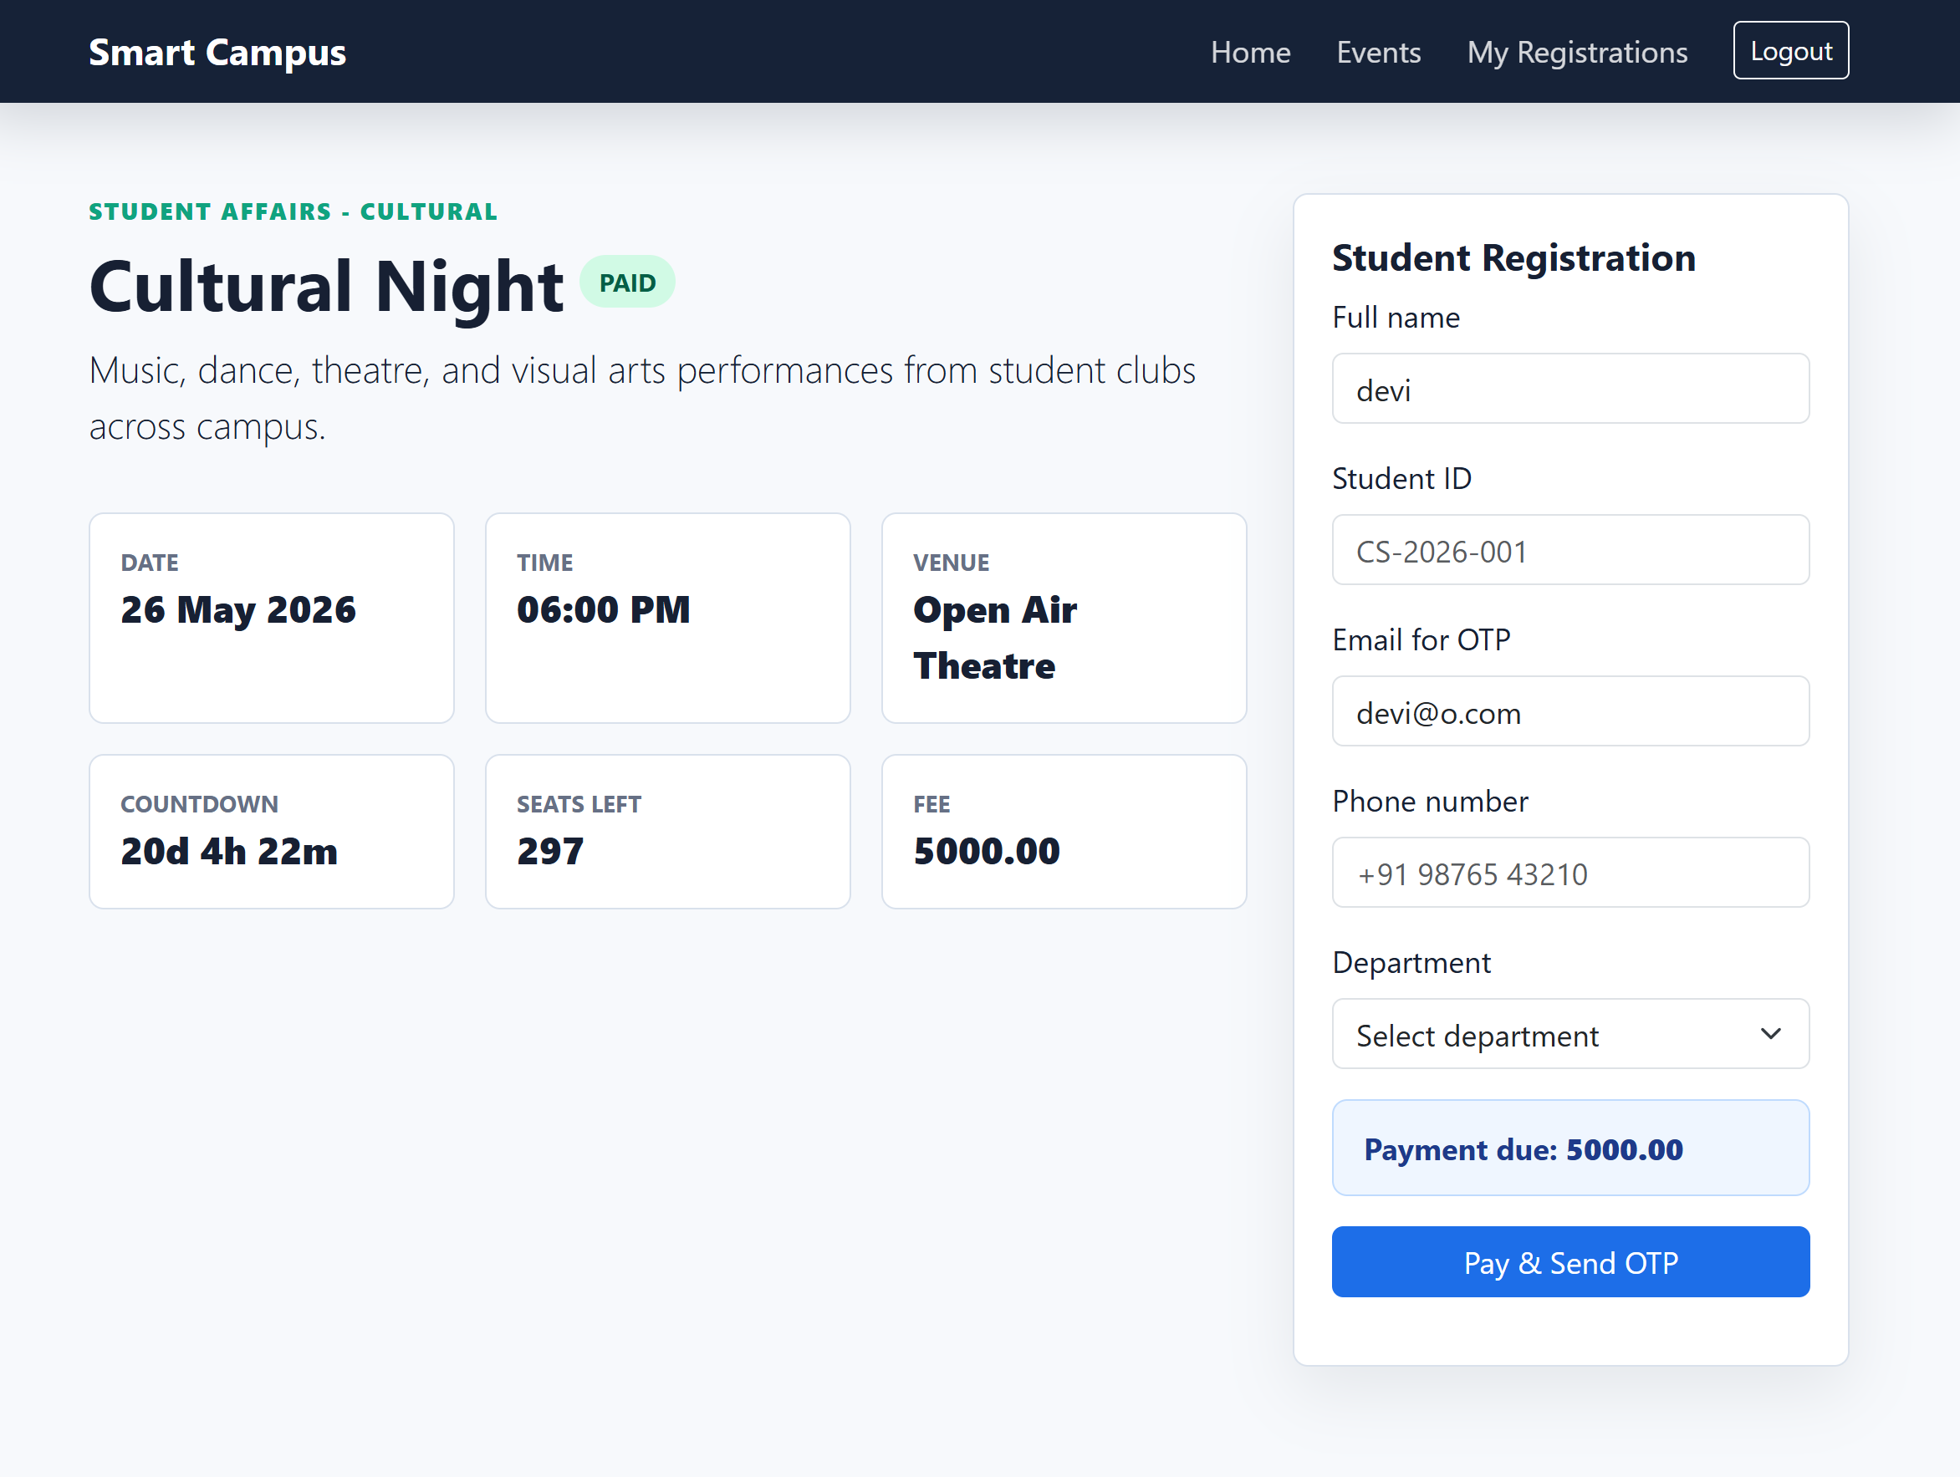
IMPLEMENTATION SCREENSHOTS
When a student selects an event, the system provides a simple registration interface where the user can confirm participation. The system validates inputs and ensures that the event capacity is not exceeded.
1
2
3
4
5
6
7
8(C)
9

Slide 14
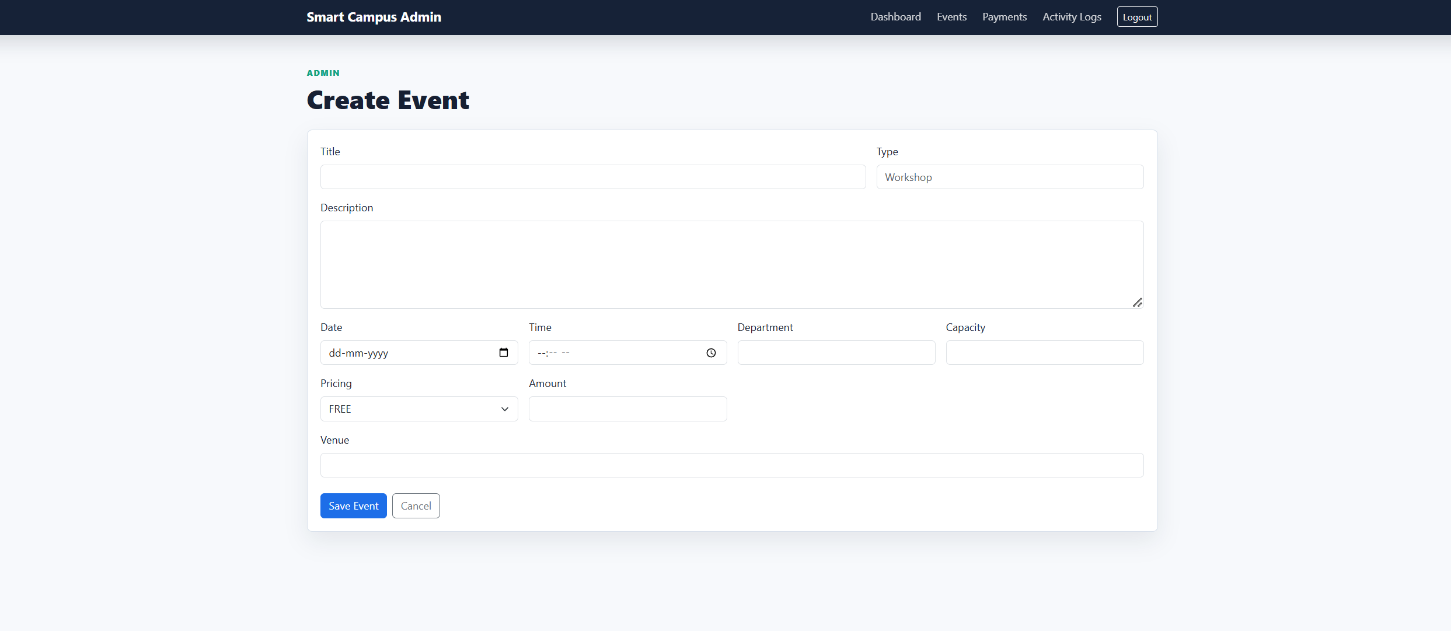
IMPLEMENTATION SCREENSHOTS
After successful registration, the system updates the user’s personal calendar with the selected events. This feature allows users to track all their registered activi_x0002_ties in an organized manner.
1
2
3
4
5
6
7
8(C)
9

Slide 15
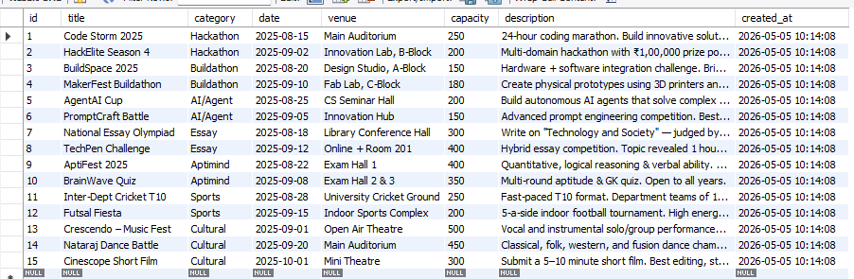
IMPLEMENTATION SCREENSHOTS
The backend successfully stores all relevant data in the MySQL database, en_x0002_suring persistence and reliability. Event details and student registrations are main_x0002_tained in structured tables, allowing efficient querying and retrieval.
1
2
3
4
5
6
7
8(C)
9

Slide 16
ADVANTAGES & LIMITATIONS
1
Advantages of the Project
• Unified Platform: Provides a single system for managing all departmental
events, eliminating scattered communication channels.
• Reliable Data Storage: Utilizes MySQL to ensure secure and long-term stor_x0002_age of event and registration data .
• Controlled Access: Authentication mechanism ensures only valid users can
access the system and perform operations.
Limitations of the Project
• Authentication Simplicity: The current login mechanism is based on basic
credential validation (registration number and date of birth), which may not
provide advanced security features such as multi-factor authentication .
• Limited Intelligent Assistance: The system does not include an advanced AI_x0002_based assistant, and hence cannot handle complex user queries or provide con_x0002_versational support dynamically
2
3
4
5
6
7
8
9

Slide 17
Thank you

